Slide 1
Kolapalli Praveen Kumar
Final Project
3/21/2024 Annual Review

Slide 2
KEYLOGGER & SECURITY
A Keylogger, Shor tfor "keystroke logger".is a type of surveillance technology used to
# A keylogger, short for "keystroke logger," is a type of surveillance technology used to monitor and record each keystroke made on a keyboard.
# Keyloggers can be implemented as either software or hardware. Software keyloggers are typically installed on a computer or mobile device, often covertly, and can capture a wide range of information, including passwords, messages, and other personal data.
# Hardware keyloggers, on the other hand, are physical devices that are connected to a computer, usually between the keyboard and the computer, to intercept and record keystrokes.
3/21/2024 Annual Review

Slide 3


The importance of understanding keyloggers and enhancing security measures against them cannot be overstated, as these tools pose a significant threat to personal and organizational data security. Keyloggers, whether implemented through software or hardware, can covertly capture sensitive information such as passwords, financial details, and private communications, leading to severe consequences like identity theft, financial loss, and corporate espionage.

Slide 4


AGENDA
A keylogger is a key stroker/keyboard capturing is a form of malware or hardware that keeps track of and records your keystrokes as you type.
It takes the information and sends it to a hacker using a command-and-control (C&C) server.
The hacker then analyzes the keystrokes to locate usernames and passwords and uses them to hack into otherwise secure systems.
3/21/2024 Annual Review

Slide 5

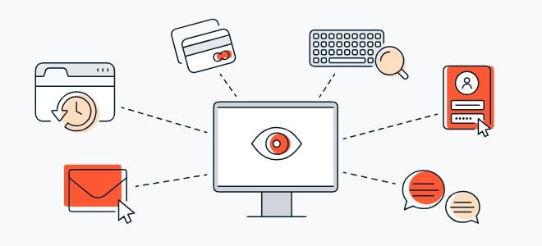
PROBLEM STATEMENT
The hacker then analyzes the keystrokes to locate usernames and passwords and uses them to hack into otherwise secure systems.
To tackle this issue we are therefore using a software keylogger that can be remotely ins
3/21/2024 Annual Review

Slide 6

PROJECT OVERVIEW
First we install the python ide and then we install the two packages.
First one is pip pynput install.
Next one is johns library.
Then these two are used for controlling mouse and keyboard.
So we can use for keylogger security.
Above like that you can install it in command prompt.
By these two libraries we cannot get error in python code.
3/21/2024 Annual Review

Slide 7
Advantages of Keyloggers:
Monitoring and Surveillance: Keyloggers can be used for legitimate monitoring purposes, such as parental control to ensure children's online safety or employee monitoring to track productivity and adherence to company policies.
Data Recovery: In situations where data is accidentally lost, keyloggers can sometimes help recover the lost information by capturing keystrokes before they are deleted.
Investigative Tool: Law enforcement agencies and legal professionals can use keyloggers as part of their investigative toolkit to gather evidence in criminal cases or track suspicious activities.
System Diagnostics: Keyloggers can assist IT professionals in diagnosing technical issues and troubleshooting problems by providing a detailed log of user interactions.

Slide 8
Disadvantages of Keyloggers:
Privacy Invasion: Keyloggers have the potential to infringe on individuals' privacy by capturing sensitive information, such as passwords, personal messages, and browsing history, without their consent or knowledge.
Misuse and Abuse: Keyloggers can be misused for malicious purposes, such as stealing passwords, financial information, or intellectual property, leading to identity theft, financial fraud, or corporate espionage.
Legal and Ethical Concerns: The use of keyloggers without proper authorization or consent may violate privacy laws and ethical principles, resulting in legal repercussions and damage to reputation if discovered.
Security Vulnerabilities: Keyloggers themselves can become targets for exploitation by cybercriminals, leading to security vulnerabilities and potential breaches if not properly secured or maintained.
Cost and Complexity: Implementing comprehensive security measures can be costly and complex, requiring investment in software, hardware, personnel training, and ongoing maintenance.

Slide 9

WHO ARE THE END USERS?
Parents might use a keylogger to monitor a child's screen time.
Companies often use keylogger software as part of employee monitoring software to help track employee productivity.
Information technology departments can use keylogger software to troubleshoot issues on a device.
3/21/2024 Annual Review

Slide 10

YOUR SOLUTION AND ITS VALUE PROPOSITION
Anti-Key-logger – As the name suggest these are the software which are anti / against key loggers and main task is to detect key-logger from a computer system.
Anti-Virus – Many anti-virus software also detect key loggers and delete them from the computer system. These are software anti-software so these can not get rid from the hardware key-loggers.
Automatic form filler – This technique can be used by the user to not fill forms on regular bases instead use automatic form filler which will give a shield against key-loggers as keys will not be pressed .
One-Time-Passwords – Using OTP’s as password may be safe as every time we login we have to use a new password.
Patterns or mouse-recognition – On android devices used pattern as a password of applications and on PC use mouse recognition, mouse program uses mouse gestures instead of stylus.
Voice to Text Converter – This software helps to prevent Keylogging which targets a specific part of our keyboard.
3/21/2024 Annual Review

Slide 11
THE WOW IN YOUR SOLUTION
To secuetre accounts in a system or computer.
In this solution the muose and keyboard control and it store in a txt file what we type on keyboard.
3/21/2024 Annual Review
11

Slide 12
MODELLING
Teams cam add wireframes
Define Keylogger Function:
Create a function to capture and log keystrokes.
Use the keyboard.on_press() method to register a callback function to capture each key press event.
Main Function:
Create a main function to start the keylogger and keep it running indefinitely.
Testing and Deployment:
Test the keylogger program to ensure it captures keystrokes correctly.
Deploy the keylogger on target systems if necessary, ensuring compliance with legal and ethical considerations.
3/21/2024 Annual Review
12

Slide 13

Import Required Modules:
Use Python's keyboard module to capture keystrokes.
Optionally, use other modules for logging, encryption, or network communication.
Set Up Logging:
Configure logging settings to specify the format and destination of log files.

Slide 14
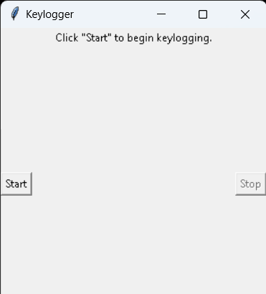
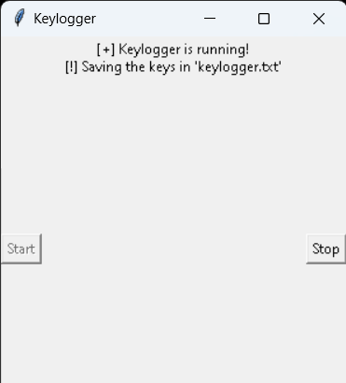
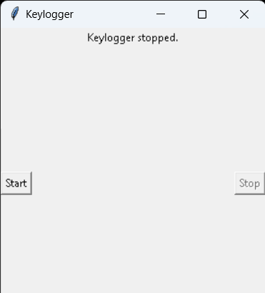
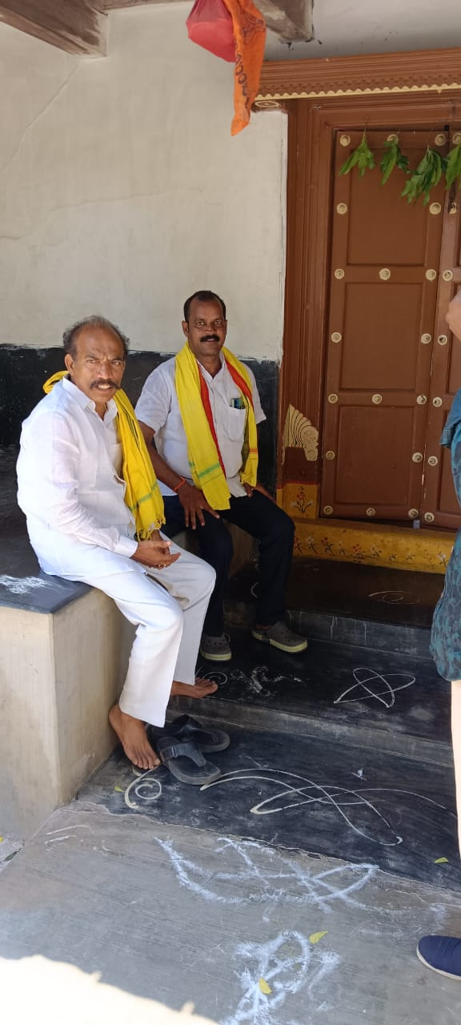
RESULTS
The result of a keylogger program typically involves capturing and logging keystrokes entered by a user on a keyboard. These logged keystrokes can then be used for various purposes, depending on the intent of the keylogger user. The covert nature of keyloggers allows them to capture sensitive information, including passwords, personal messages, and financial details, without the user's knowledge or consent. This poses serious risks to individuals, organizations, and society at large, including identity theft, financial fraud, and unauthorized access to confidential data.
3/21/2024 Annual Review
14

Slide 15
Project Link

Slide 16
Project link
https://github.com/Praveen27-09/APSSDC_PROJECT/blob/main/keylogger_praveen.py

